Slide 1
Results of the First Customs Integrity Perception Survey (CIPS) in Ukraine
Shanshan YU
A-CIP meeting with SCS, EU4PM
Data analyst of A-CIP Programme
23 July 2025

Slide 2
Looking back at the 2024 CIPS
1. Measuring corruption specific to Customs
The CIPS focuses specifically on corruption in the Customs environment through the 10 ken factors of the WCO Revised Arusha Declaration.
2. Providing a baseline assessment
The 2024 CIPS provided the SCS with a baseline assessment of how its integrity level is perceived, both internally and externally.
3. Comparing internal and external perception
The perception of Customs officials at SCS and that of the private sector representatives are aligned for most key factors, while gaps still exist for a few others.
4. Bridging principle & implementa-tion
The 2024 CIPS results show that there is still a gap between the existence of the integrity principle and its actual implementation.
5. Aligning multiple WCO integrity tools
The PMM's KPIs can cross-check the CIPS results, either validating the perception or revealing discrepancies. The IDG offers a checklist to identify causes of the gap between the existence and implementation of integrity policies as well as insights on how to close it.

Slide 3
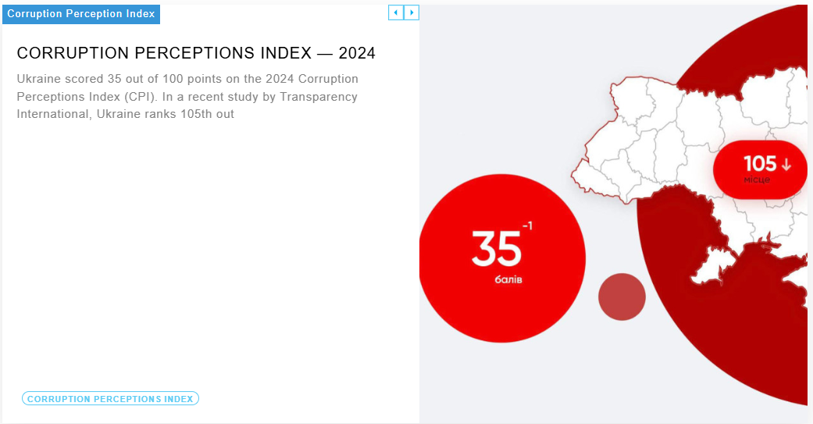
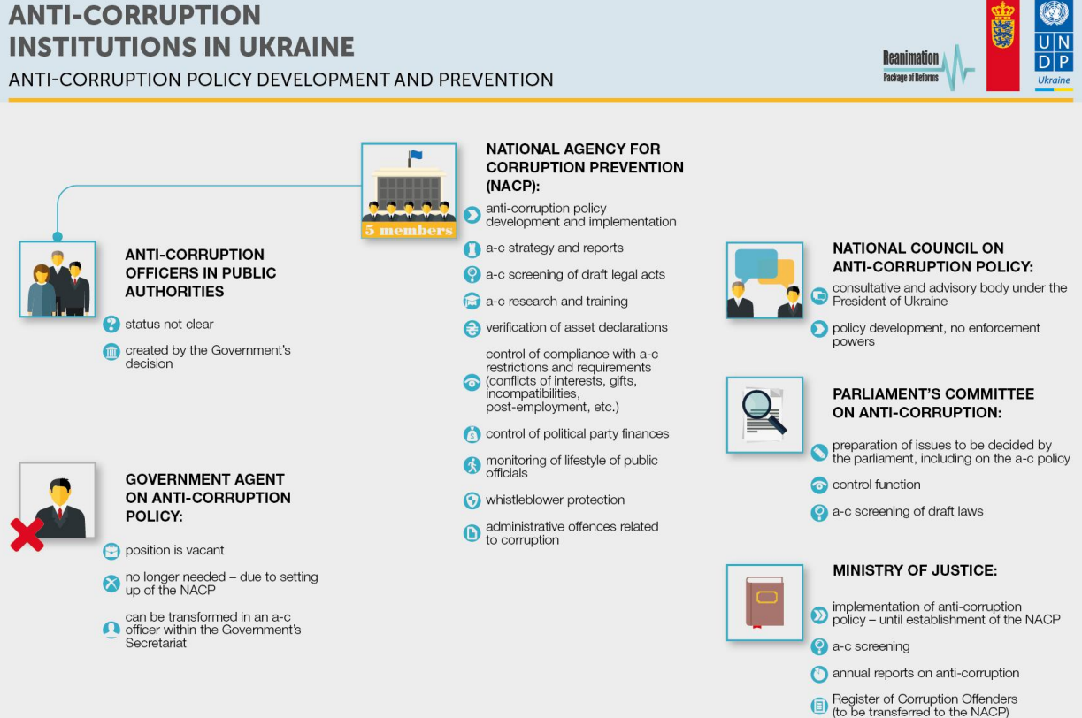
1. Measuring corruption specific to Customs
2. Providing a baseline assessment
3. Comparing internal and external perception
4. Bridging integrity principle and implementation
5. Aligning multiple WCO integrity tools
The CIPS focuses specifically on corruption in the Customs environment through the 10 ken factors of the WCO Revised Arusha Declaration (RAD).
Transparency International
Anti-corruption institute at the national level
vs
Challenges specific to State Customs Service (SCS)

Slide 4
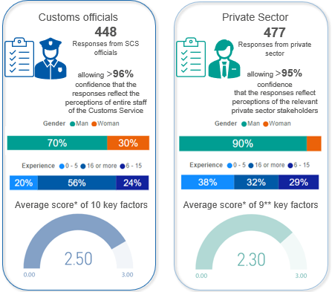
1. Measuring corruption specific to Customs
2. Providing a baseline assessment
3. Comparing internal and external perception
4. Bridging integrity principle and implementation
5. Aligning multiple WCO integrity tools
The first CIPS in September 2024 provided the SCS with a baseline assessment of how its integrity level is perceived, both internally and externally.
Survey design?
4-point Likert scale
Sampling?
Region?
Sample size?
Involvement of large corporations?
Social bias
*CIPS questions are designed based on a 4-point Likert scale. A weighted mean, or a score, can be calculated for each question. The most positive response has the greatest weight, 3, and the least positive response, 0.
The maximum of the weighted mean is 3, and the minimum is 0. The higher the weighted mean, the more positive is the result of a certain indicator. The score of a key factor is the average of the all questions of the key factor.
** Human resource management is not part of the private sector survey.

Slide 5
1. Measuring corruption specific to Customs
2. Providing a baseline assessment
3. Comparing internal and external perception
4. Bridging integrity principle and implementation
5. Aligning multiple WCO integrity tools
The perception of SCS officials and that of the private sector representatives are aligned for most key factors of the Revised Arusha Declaration (RAD), whereas gaps still exist for key factors Regulatory Framework and Relationship with the Private Sector.

Slide 6
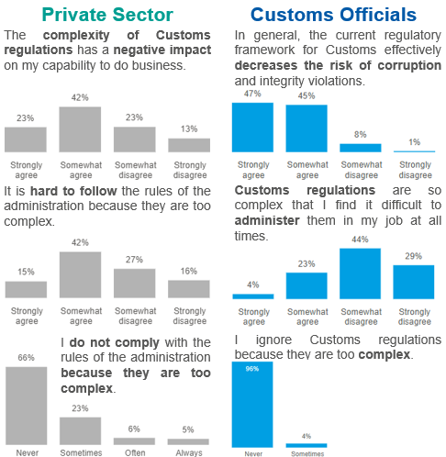
1. Measuring corruption specific to Customs
2. Providing a baseline assessment
3. Comparing internal and external perception
4. Bridging integrity principle and implementation
5. Aligning multiple WCO integrity tools
Example 1:
Diverging internal and external views on regulations
…the private sector appears to be more affected by the complexity of Customs regulations

Slide 7
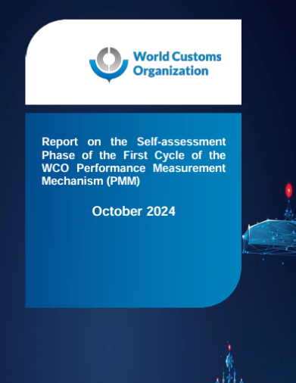
1. Measuring corruption specific to Customs
2. Providing a baseline assessment
3. Comparing internal and external perception
4. Bridging integrity principle and implementation
5. Aligning multiple WCO integrity tools
Example 1:
Diverging internal and external views on regulations
…the private sector appears to be more affected by the complexity of Customs regulations
-> But to what extent?
In the WCO Performance Measurement Mechanism (PMM), KPIs are developed
to capture the degree of non-compliance as well as to understand the reasons of it ->
1. Degree of non-compliance with classification rules
to measure the number of cases subject to fines as a result of non-compliance ->
2. Percentage of fines administered
to measure the number of importers who are not in full compliance with revenue requirements ->
3. Percentage of importers paying interest
*In the 2024 self-assessment of the PMM, SCS did not provide data for these KPIs due to the fact that the national database does not contain this level of details.

Slide 8
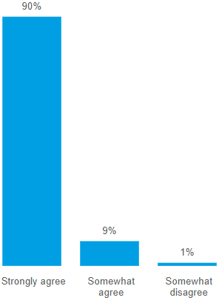


1. Measuring corruption specific to Customs
2. Providing a baseline assessment
3. Comparing internal and external perception
4. Bridging integrity principle and implementation
5. Aligning multiple WCO integrity tools
Customs officials
Example 2:
Diverging internal and external views on the relationship with the private sector
My day-to-day interaction with the private sector is professional and correct.
Gap?
Does the Customs administration have established mechanisms to enable periodic engagement with the private sector to discuss Customs-specific issues?
Does/Do the group(s) meet in accordance with established timeframes and at least on a biannual basis?
Does/Do the group(s) meet and communicate new information to industry “as needed” ?
Does/Do the group(s) meet to facilitate discussions on specific topics?
Does/Do the group(s) have established Terms of Reference in place to enable good governance?
Does/Do the group(s) have a designated representative from the Customs administration that is responsible for industry engagement?
Is there a designated representative from the Customs administration that is responsible for coordination with partner agencies?
Are there mechanisms to ensure transparency with the public regarding the group’s deliberations?
Does/Do the group(s) the groups have established mechanisms to keep track of the recommendations from all involved for appropriate follow-up purposes?
Institutional vs individual
66.7%
Maturity of private sector engagement
2024 self-assessment of PMM

Slide 9
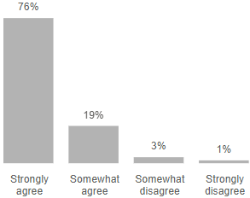
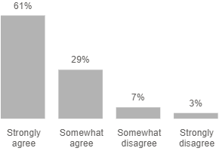
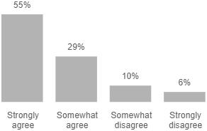
1. Measuring corruption specific to Customs
2. Providing a baseline assessment
3. Comparing internal and external perception
4. Bridging integrity principle and implementation
5. Aligning multiple WCO integrity tools
The 2024 CIPS results revealed that the SCS generally has sufficient guidelines and principles of integrity. However, there is still a gap between the existence of the integrity principle and its actual implementation, as perceived.
Example 3:
Leadership - from words to action
Achieving a high level of integrity is considered a priority within the Customs administration.
Customs administration management sets a positive example when it comes to integrity.
Customs administration management is taking action against corruption.
Private
Sector
…a trend also evident in the global CIPS results

Slide 10
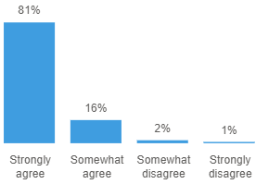
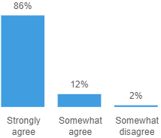

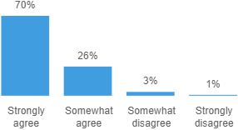
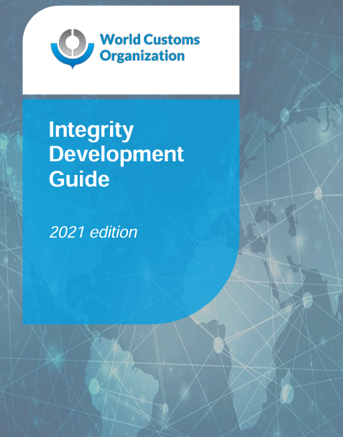



1. Measuring corruption specific to Customs
2. Providing a baseline assessment
3. Comparing internal and external perception
4. Bridging integrity principle and implementation
5. Aligning multiple WCO integrity tools
Recognizing the perceived gap between words and actions, the WCO Integrity Development Guide (IDG) provides the SCS with a checklist to identify the causes of these gaps and ways to close them.
Example 3:
Leadership - from words to action
In general, achieving a high level of integrity is considered a priority within the administration.
My direct supervisor(s) sets a positive example when it comes to integrity.
SCS’ top management sets a positive example when it comes to integrity.
The first part of the checklist focuses on the broad government level commitment to integrity. Political leadership and a commitment to fight corruption at the highest levels is a pre-requisite for initiating and sustaining reforms over time, until results are achieved.
Does SCS have an integrity program or strategy? Is it linked to the government strategy?
Whole-of-government approach
Customs
Officials
How does SCS communicate its integrity efforts to the Minister or the highest government executive, and vice versa?
Achieving a high level of integrity is considered a priority within the Customs administration.
Customs administration management sets a positive example when it comes to integrity.
Customs administration management is taking action against corruption.
What arrangements are in place to maintain and increase government support?
Private
Sector
Are adequate resources made available to SCS to allow efficient and effective fulfillment of its functions?
…a trend also evident in the global CIPS results

Slide 11

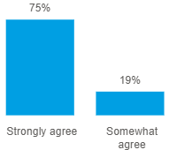
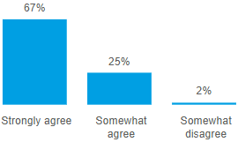
1. Measuring corruption specific to Customs
2. Providing a baseline assessment
3. Comparing internal and external perception
4. Bridging integrity principle and implementation
5. Aligning multiple WCO integrity tools
The practical and unambiguous terms in the development and the issue of CoC guarantees its acceptance and application. Respondents from SCS displayed a higher level of confidence in the clarity of their CoC, while the level of confidence slightly dropped for the fairness of the CoC’s application and its positive impact.
Example 4:
Code of conduct – from existence to application
“Is there a code of conduct applicable to your Customs administration?”
“The code of conduct is clear to me.”
“The code of conduct is applied in a fair manner. “
Customs officials

Slide 12
1. Measuring corruption specific to Customs
2. Providing a baseline assessment
3. Comparing internal and external perception
4. Bridging integrity principle and implementation
5. Aligning multiple WCO integrity tools
A key element of any effective integrity programme is the development, issue and acceptance of a comprehensive code of conduct which sets out in very practical and unambiguous terms the behaviour expected of all Customs personnel.
Example 4:
Code of conduct – from existence to application
In general, achieving a high level of integrity is considered a priority within the administration.
My direct supervisor(s) sets a positive example when it comes to integrity.
SCS’ top management sets a positive example when it comes to integrity.
Are effective disciplinary measures for non-compliance with the code of conduct in effect in Customs or public sector legislation?
Penalty regime for non-compliance
Penalties for non-compliance should be articulated in the code, calibrated to correspond to the seriousness of the violation, and supported by appropriate administrative and legislative provisions
Customs
Officials
What are the mechanisms in place for employees to report suspected breaches of the code of conduct?
Achieving a high level of integrity is considered a priority within the Customs administration.
Customs administration management sets a positive example when it comes to integrity.
Customs administration management is taking action against corruption.
What are the procedures in place to investigate alleged or suspected breaches of the code of conduct?
Private
Sector
Has the introduction of a limited amnesty been considered for minor breaches of the Code as an element of the integrity strategy?
…a trend also evident in the global CIPS results

Slide 13
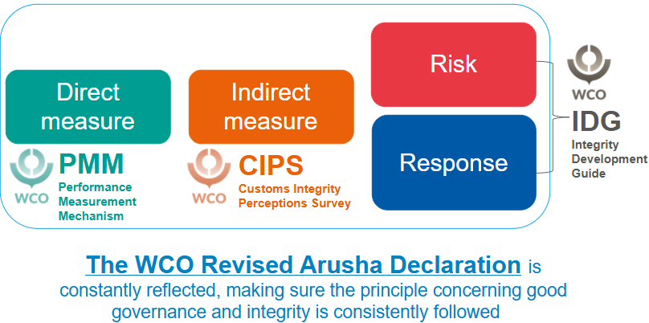
1. Measuring corruption specific to Customs
2. Providing a baseline assessment
3. Comparing internal and external perception
4. Bridging integrity principle and implementation
5. Aligning multiple WCO integrity tools
Adapted from United Nations Convention Against Corruption (UNCAC): a statistical framework to measure corruption

Slide 14
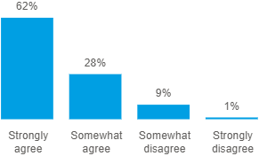
1. Measuring corruption specific to Customs
2. Providing a baseline assessment
3. Comparing internal and external perception
4. Bridging integrity principle and implementation
5. Aligning multiple WCO integrity tools
Direct measure
Indirect measure
Example 5:
Audit & investigation – whistleblowing
72+
Whistleblowers
“How to react when suspecting that a colleague accepts money from business to ignore procedures?”
5000+
Corruption reports
“I feel safe enough to report integrity violations. “
2024 NACP report
99.1%
Reports trigger an investigation
2024 self-assessment of PMM
Percentage of SCS officials subject to disciplinary measures
2024 self-assessment of PMM
0.24%

Slide 15
1. Measuring corruption specific to Customs
2. Providing a baseline assessment
3. Comparing internal and external perception
4. Bridging integrity principle and implementation
5. Aligning multiple WCO integrity tools
Disclosure and whistleblower protection
✗ | ✔ | Do you have legislation, policies, and procedures in place to facilitate the reporting of wrongdoing? If so, does the legislation allow for the anonymous disclosure of wrongdoing?
✗ | ✔ | Are the legislation, policies, and procedures made easily accessible to employees, stake- holders, and the public? Are employees made aware of their responsibilities in reporting cases of wrongdoing?
✗ | ✔ | If an employee reports a case of wrongdoing, is their confidentiality protected and are they protected against reprisal?
✗ | ✔ | Is it mandatory to report suspected or known cases of wrongdoing? If so, are employees aware of this?
✗ | ✔ | Has an independent third party been identified and authorized to receive complaints of employees being unfairly treated as a direct or indirect consequence of the reporting?
✗ | ✔ | Are there mechanisms in place for employees, clients, stakeholders, and the general public to report instances of wrongdoing? If so, are they well communicated?
✗ | ✔ | Is there a system in place for managing complaints against employees?
Risk
Response
IDG checklist
Example 5:
Audit & investigation – whistleblowing

Slide 16
1. Measuring corruption specific to Customs
2. Providing a baseline assessment
3. Comparing internal and external perception
4. Bridging integrity principle and implementation
5. Aligning multiple WCO integrity tools
investigation
✗ | ✔ | Do the investigators receive training in interview and interrogation techniques?
✗ | ✔ | Do investigators have the legal authority to conduct investigations?
✗ | ✔ | Are findings from investigations incorporated in prevention and training strategies?
✗ | ✔ | Where large-scale or complex investigations are warranted, is there access to independent anti-corruption or investigation authorities?
✗ | ✔ | Are investigations conducted at arm’s length between investigators and employees?
✗ | ✔ | Is procedural fairness maintained throughout the investigation?
✗ | ✔ | Is there a formalized discipline process to take action as a result of an investigation?
✗ | ✔ | Is the data from investigations analyed to identify trends, vulnerabilities, and opportunities for improvement?
Risk
Strengthened internal control
✗ | ✔ | Has an internal control or internal affairs unit been established to investigate cases of malpractice?
✗ | ✔ | What is the legal framework defining the responsibilities and competences with respect to internal control?
✗ | ✔ | What mechanisms are in place to ensure the independence of internal control?
Example 5
continued
IDG checklist

Slide 17
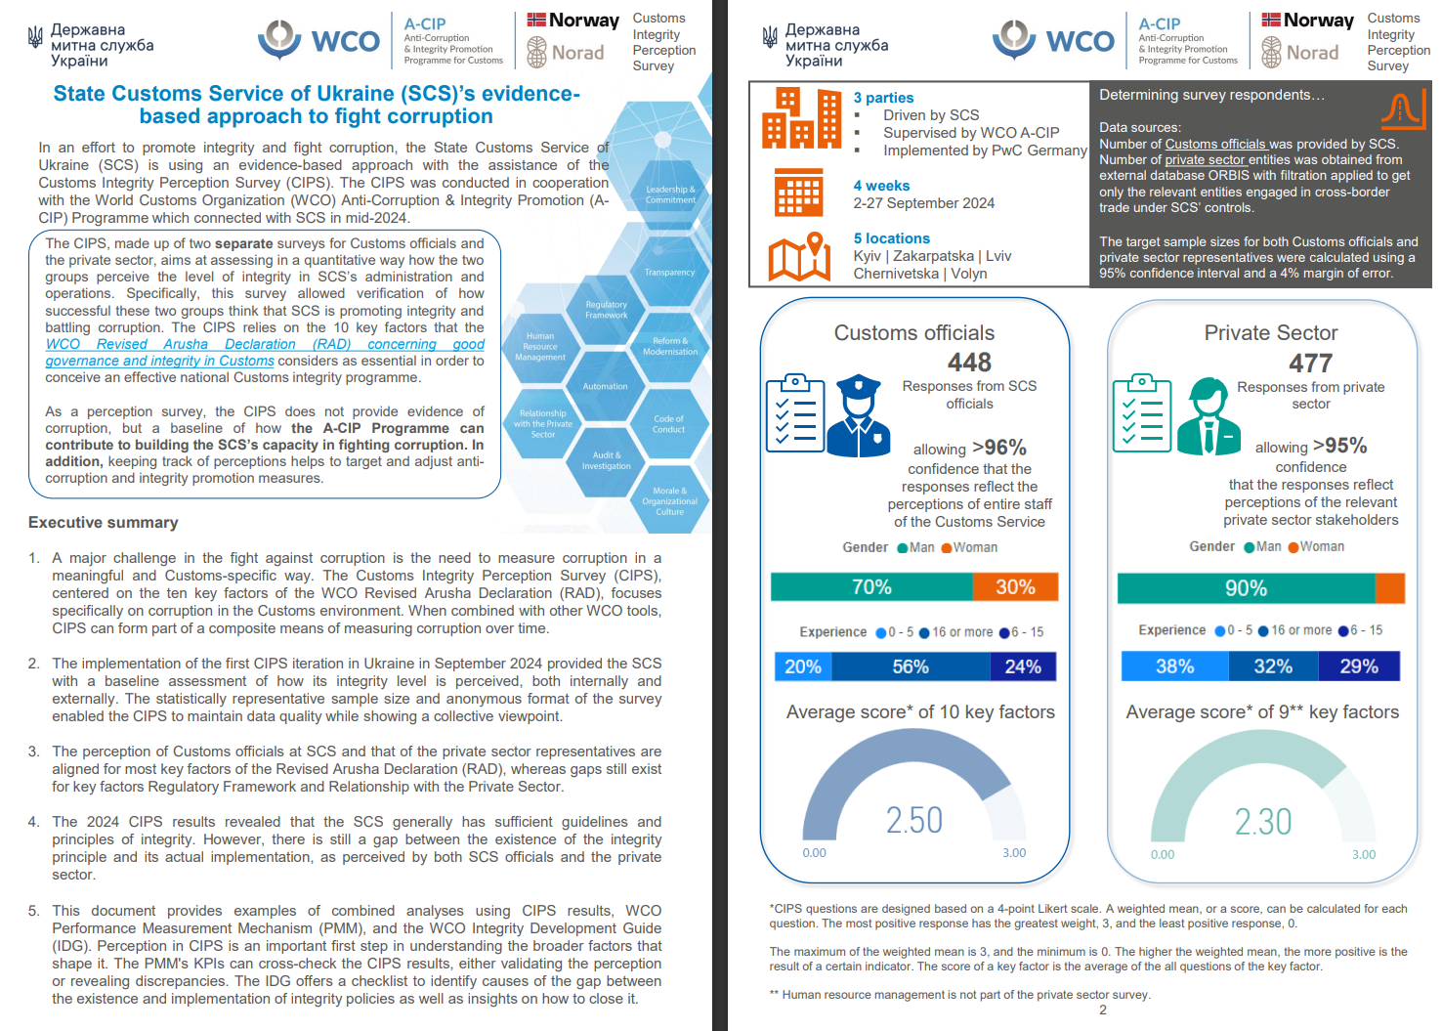
1. Measuring corruption specific to Customs
2. Providing a baseline assessment
3. Comparing internal and external perception
4. Bridging integrity principle and implementation
5. Aligning multiple WCO integrity tools
For full information:

Slide 18

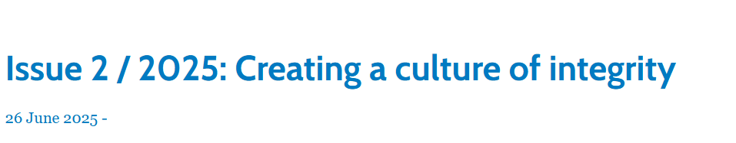
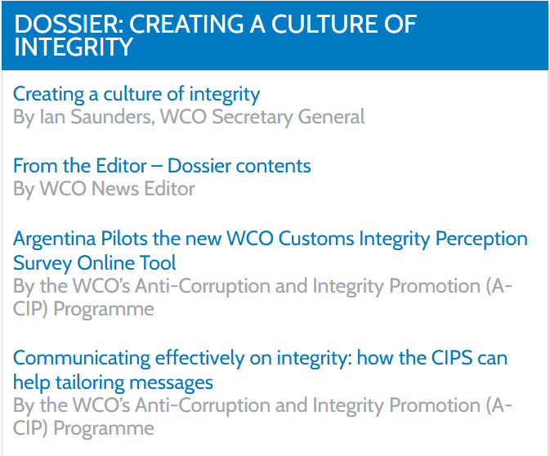
1. Measuring corruption specific to Customs
2. Providing a baseline assessment
3. Comparing internal and external perception
4. Bridging integrity principle and implementation
5. Aligning multiple WCO integrity tools
Other examples of the usage of CIPS
link

Slide 19

Thank you!

