Slide 1
Electronic issuance of movement certificates
THE STATE CUSTOMS SERVICE OF UKRAINE

Slide 2
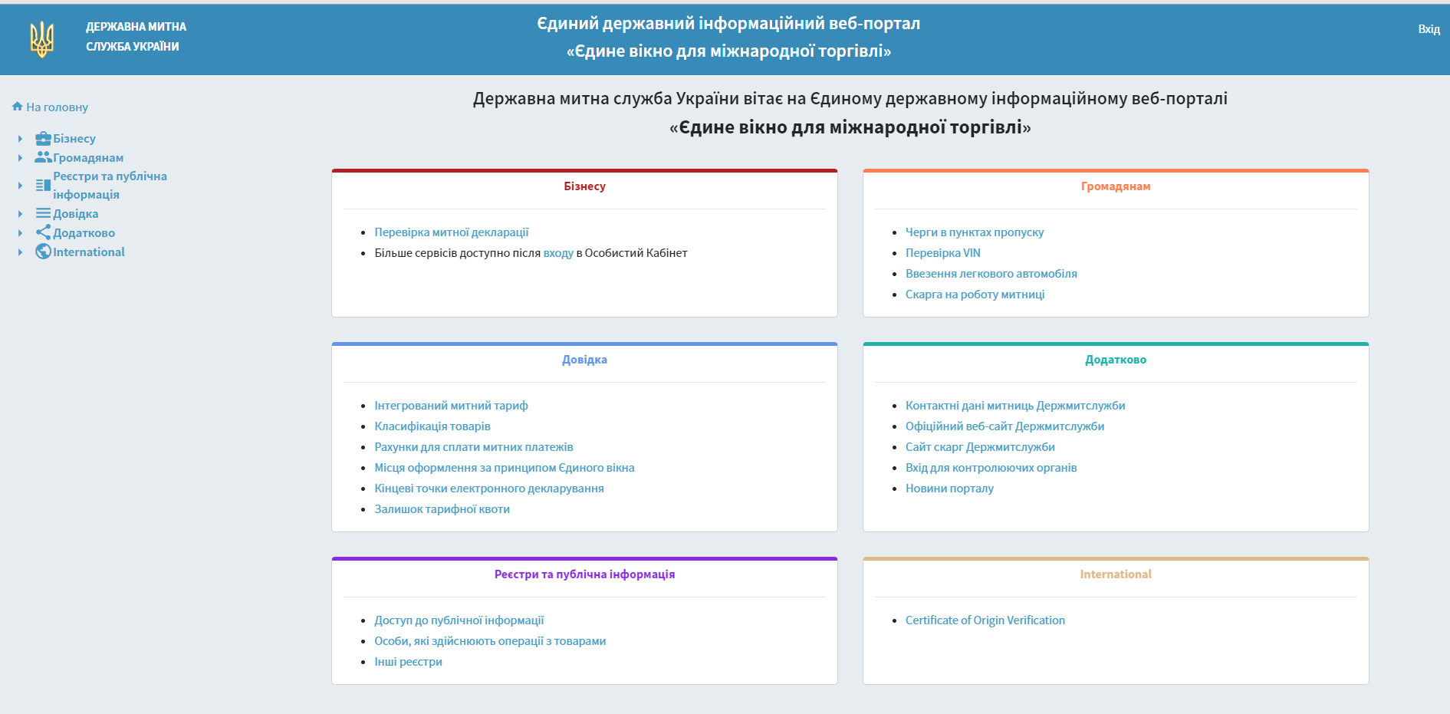
The service of verification
of EUR.1 movement (origin) certificates
(the first method)
Website to verification of movement certificates EUR.1
‘Single Window for International Trade’ Unified State Information Web Portal.
https://cabinet.customs.gov.ua/certorigcheck

Slide 3
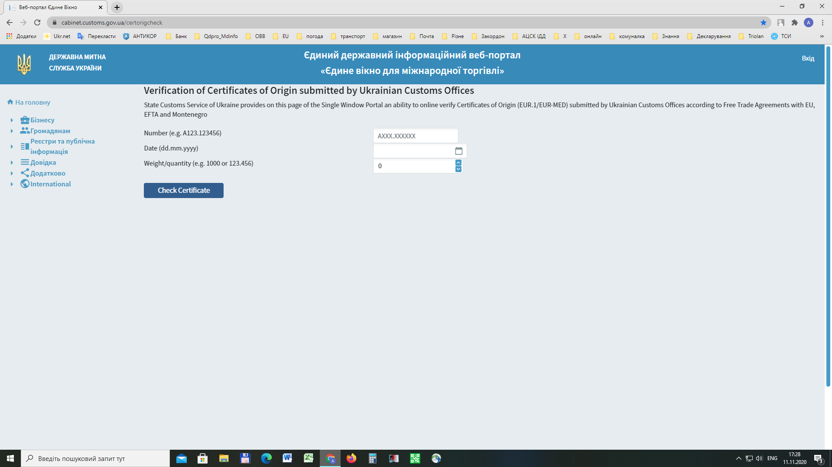
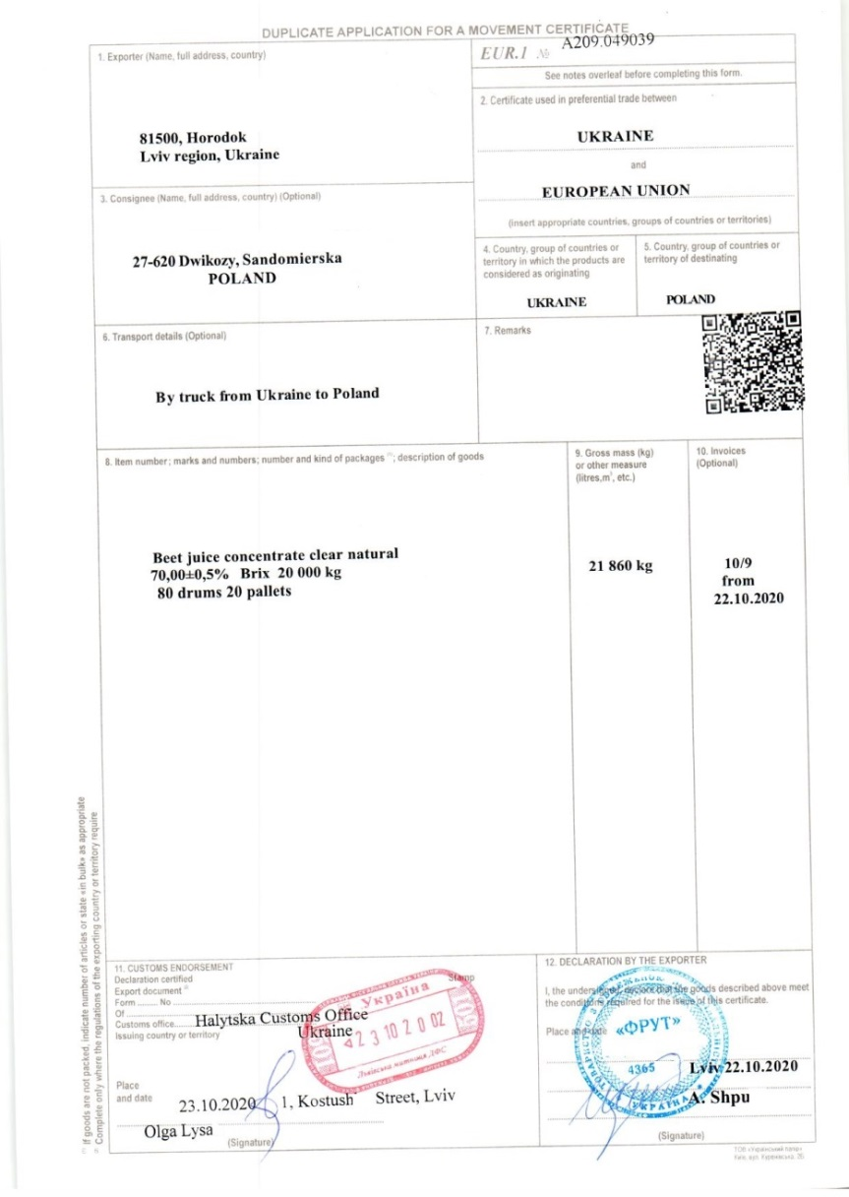
The service of verification
of EUR.1 movement (origin) certificates
(the first method)

Slide 4
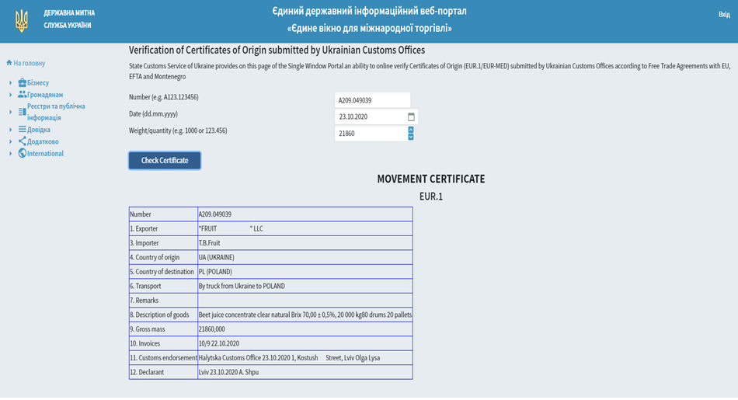
The service of verification
of EUR.1 movement (origin) certificates
(the first method)
Result of verification

Slide 5
The service of verification
of EUR.1 movement (origin) certificates
(the second method)
Issuing EUR.1 certificates in their column 7 is QR-code (two-dimensional bar code)
Scanning device (including a smartphone camera) allows to ascertain the fact of EUR.1 certificate issuance and view electronically the information

Slide 6
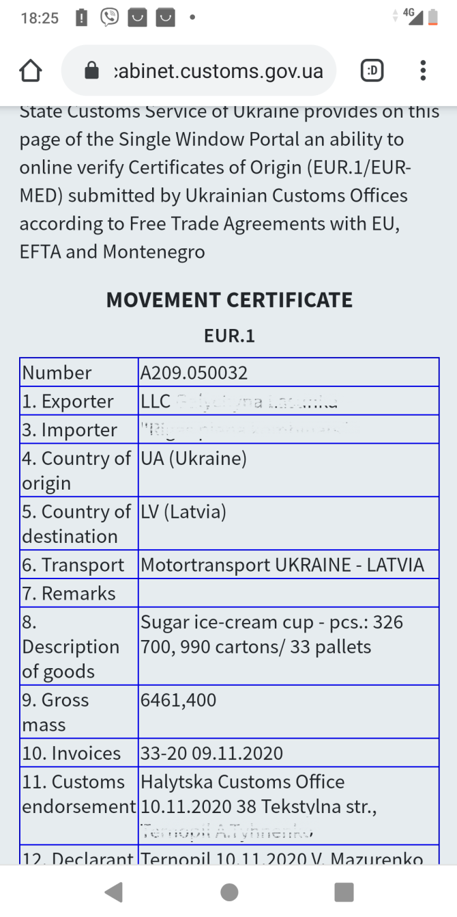
The service of verification
of EUR.1 movement (origin) certificates
(the second method)
Result of verification on scanning device

Slide 7
Electronic issuance of movement certificates
THE END

